Slide 1


SEE WHAT TRUMP SAYS ABOUT T5

Slide 2



DEEP FAKE DETECTION
By
Abdulaziz Alnajjar, Saad Almoghirh, Salem Bawazir
Notes:
1 - تقديم

Slide 3


SCENARIO
In 2019, a CEO of a UK-based energy firm was scammed out of $243,000 by criminals using an AI-generated audio deep fake of his boss's voice.

Slide 4
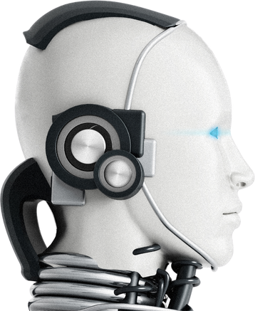
SCENARIO
In 2023, a Mother was targeted by a scammer that claimed to be her daughter.

Slide 5
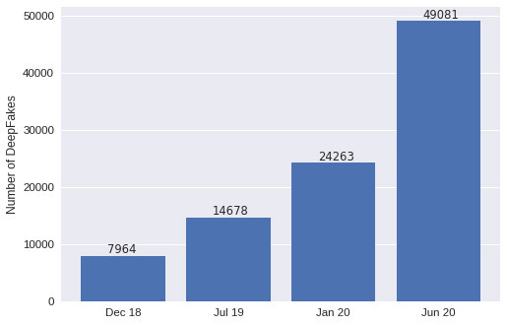
STATISTICS
Notes:
في هذه الاحصائيات عدد deepfakes
على مر السنوات
بداية في 2018 كان م يقارب 8 الاف
وفي 2019 تضاعف الى ضعف اعداد السنة الي قبلها
والمحتوى راح تكون متنوعة من الاصوات والفيديوهات والصور وجميع الاعداد الظاهرة تم استخدامها في ايذاء الشخصيات العامة والتي لديها مكانة مهمه في المجتمع

Slide 6

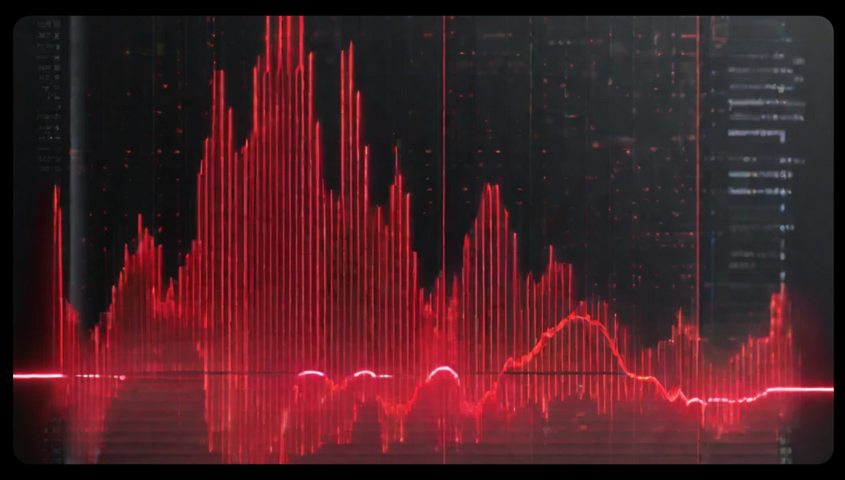


PROBLEM STATEMENT
The world right now is suffering from deep fake medias in a political or religious way
Our solution should advance the world to a world free of conflict over fake media

Slide 7

SOLUTION
OUR SOLUTION IS TO DEVELOP AN AI SOFTWARE TO PREVENT THE RISE OF AUDIO DEEP FAKES.

Slide 8
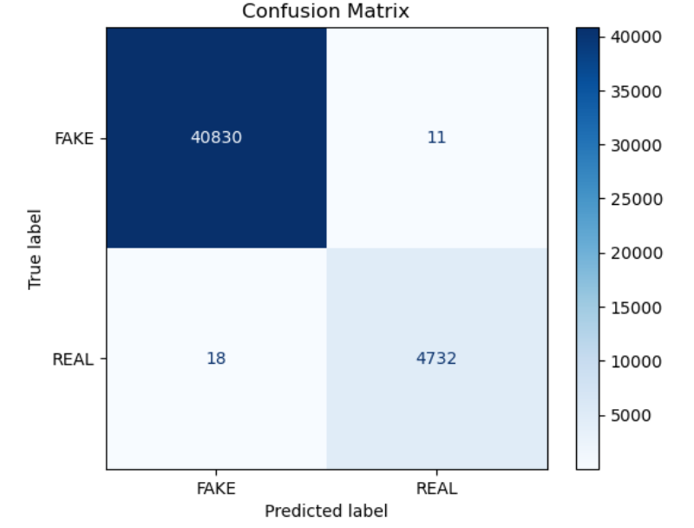
MODEL
Notes:
اااي

Slide 9
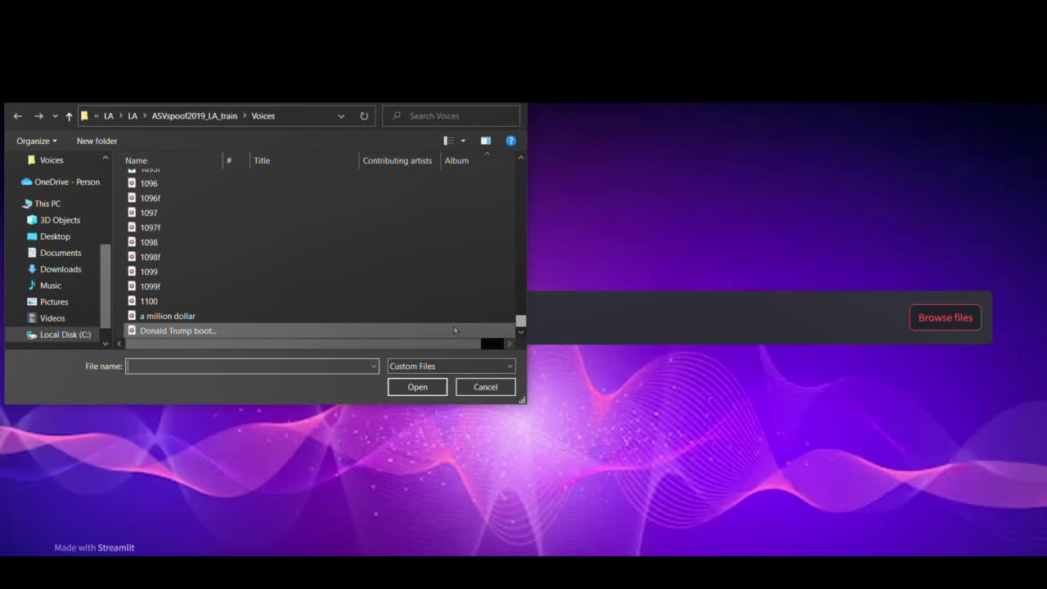
DEMO

Slide 10

FUTURE WORK
For our future work will focus on refining the model to detect more sophisticated softwares and integration of the model with real-time hardwares. As well as the following:
Finally, after completing these milestones, next up is to interpret based on what does our model predict for these three projects.
Next big milestone is to develop a model that can detect deepfake images.
After completing deepfake image detection, the next milestone is to develop deepfake detection for videos.
INTERPRETABILITY
DEEPFAKE IMAGE DETECTION
Deepfake image Deepfake image detection
DEEPFAKE VIDEO DETECTION

Slide 11

THANK YOU
Any Questions ?

